Slide 1
Welcome to Marketing Management
Dr. Cecilia Ruvalcaba
BUSI 107 Week 8, Day 1

Slide 2
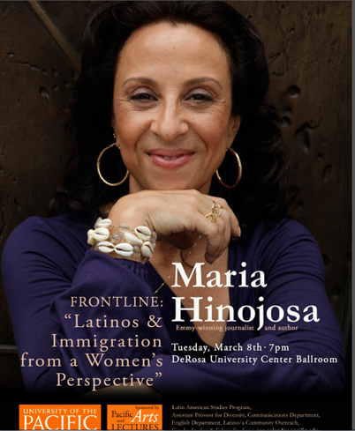

Slide 3
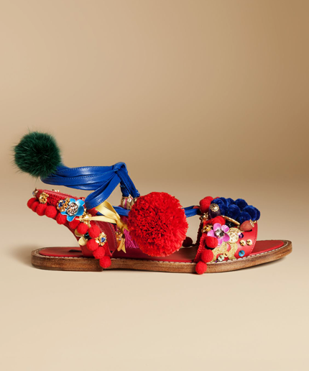
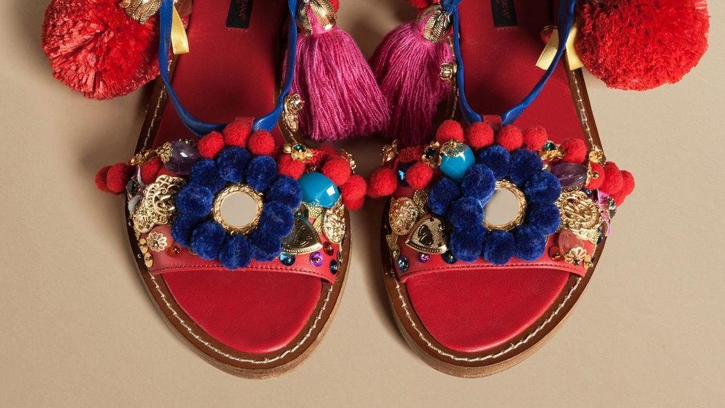

Notes:
Dolce & Gabbana: The Slave Sandal
http://hellobeautiful.com/2016/03/04/dolce-and-gabbana-create-colorful-slave-sandal/

Slide 4
Products & brands

Slide 5

Brands
Brand Image
Perceptions about a brand as reflected by brand associations that consumers hold in their memories.
Brand Equity
The total value that accrues to a product as a result of a company’s cumulative investments in the marketing of the brand.
“Your brand is what other people say about you when you’re not in the room.”
-Jeff Bezos (Amazon)

Slide 6
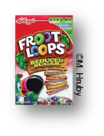


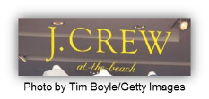
What Makes a Brand?
McGraw-Hill Companies, Inc.
Logos and symbols
Characters
URLs
www.eBay.com
Slogans
Branding
©M. Hruby.
Brand name
Jingles/Sounds
“Law & Order”
Notes:
Nationwide- Peyton Manning http://www.ispot.tv/ad/7Mhd/nationwide-insurance-jingle-featuring-peyton-manning

Slide 7
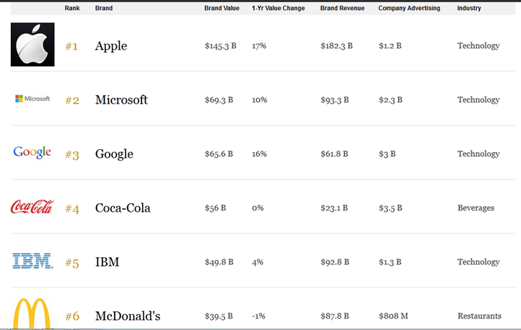
Value in Branding
Facilitate Purchasing
Establish Loyalty
Protect from Competition
Are Assets
Impact Market Value
Forbes 2015 list
Notes:
http://www.forbes.com/powerful-brands/list/#tab:rank

Slide 8
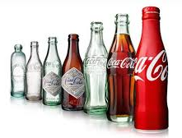
Brand Equity Benefits
Greater loyalty
Less vulnerability to marketing actions or crises
Larger margins
More inelastic consumer response to price increases
More elastic consumer response to price decreases
Increased marketing communication effectiveness

Slide 9
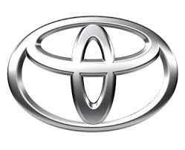
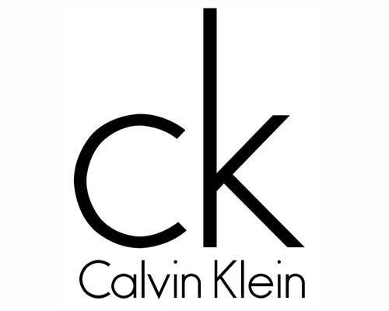
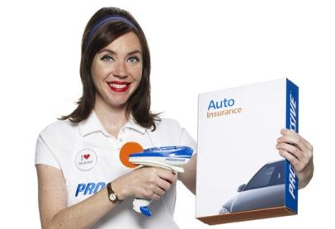
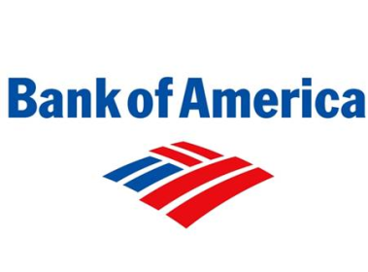
Brand Equity
Brand Awareness
Perceived Value
Brand Association
Brand Loyalty

Slide 10


Take Away for Today
Understanding your brand.
What is your brand?
What are people saying about your brand?
Brand Equity
The smallest detail can be a significant contributor

Slide 11

Next Class
Chapter 11: Product, Branding, and Packaging Decisions & Chapter 12: Developing New Products cont…
Extended Outline due Friday 3/11

